Slide 1





Bari, 21 Settembre 2023
Ambiente, epigenetica e prevenzione
Agostino DI CIAULA
Clinica Medica «Augusto Murri» - University of Bari, Italy
International Society of Doctors for Environment (ISDE)
AOUC Policlinico di Bari
International Society of Doctors for Environment (ISDE)

Slide 2


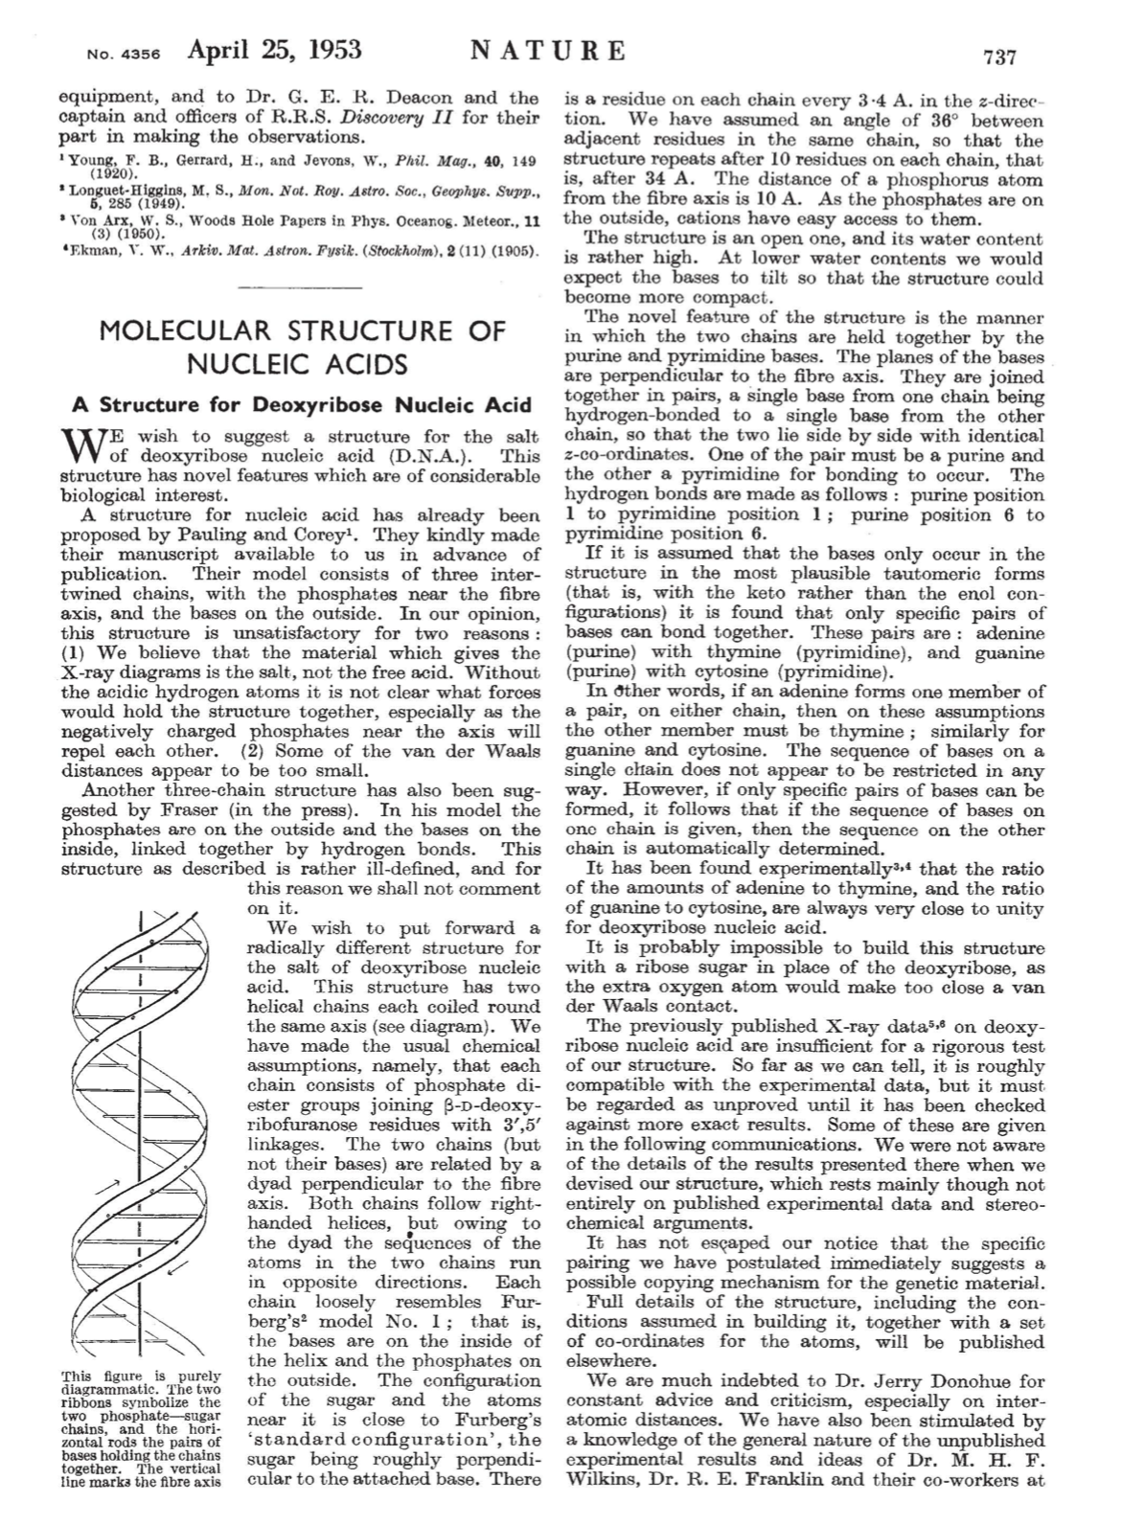
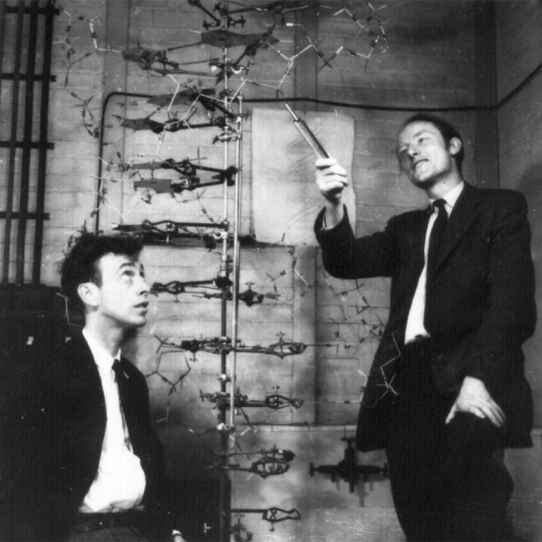
1953
James Watson and Francis Crick

Slide 3
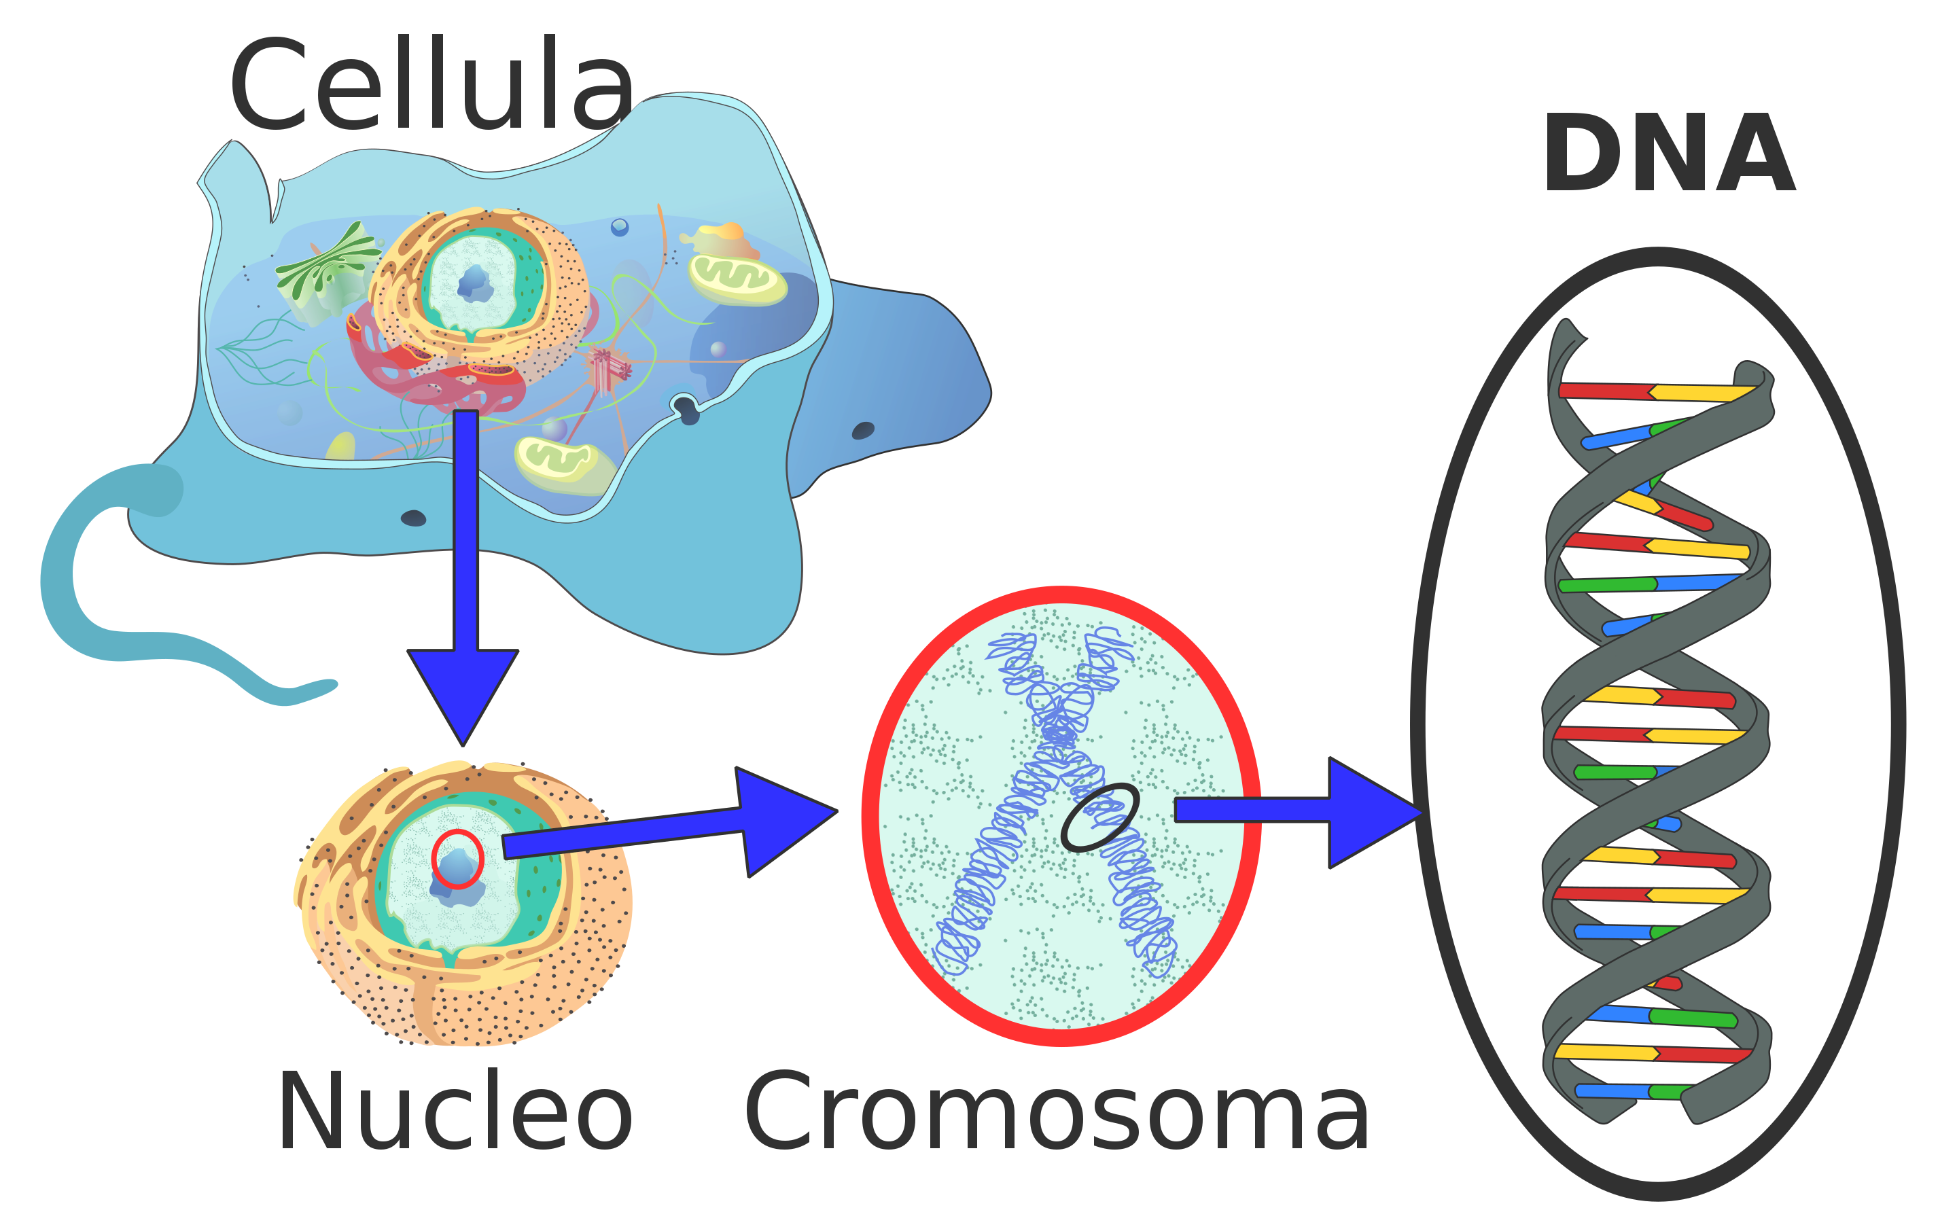
Geni → codici per costruire proteine
Fino a non molto tempo fa si riteneva che la genetica avrebbe svelato i segreti della vita…

Slide 4
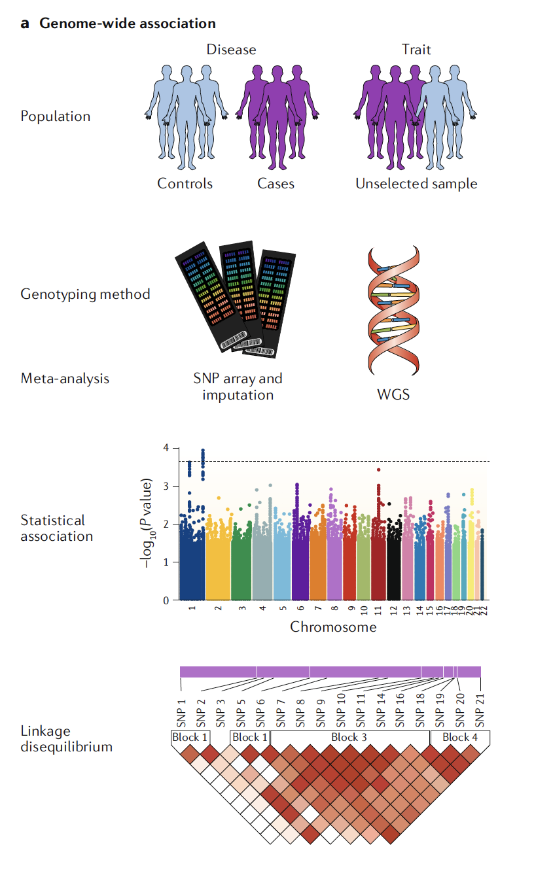
Genome Wide Association Studies (GWAS)
"Since the first GWAS for age- related macular degeneration (AMD) was published in 2005, more than 50,000 associations of genome-wide significance have been reported between genetic variants and common diseases and traits"
(Tam et al, Nature 2019)

Slide 5
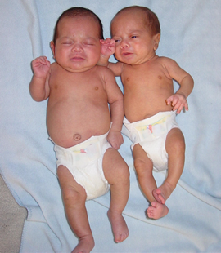
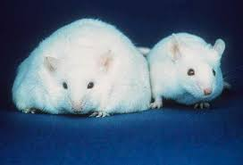
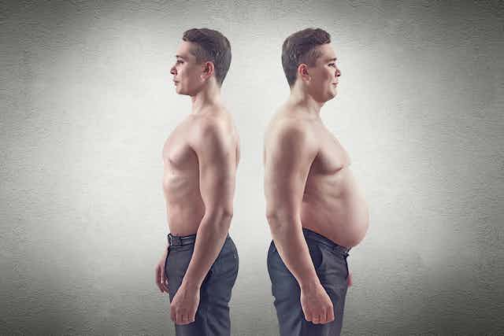
…poi è arrivata l'epigenetica
GWAS → correlazioni, non rapporto di causalità
Non è tanto importante avere determinati geni, quanto il fatto che quei geni si esprimano o meno !

Slide 6
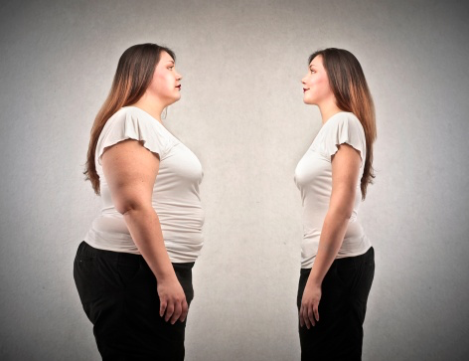
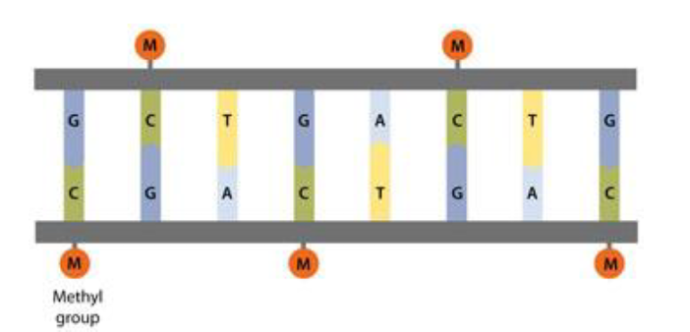
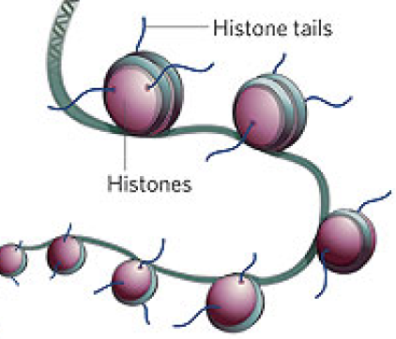
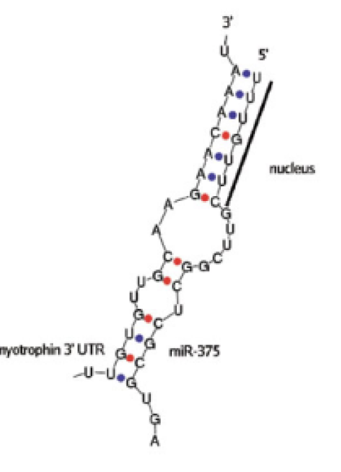
Che cos'è l'epigenetica?
La capacità di modificare l'attività dei geni senza modificare la sequenza del DNA (assenza di mutazioni)
3 meccanismi principali:
Metilazione del DNA ("silenziamento" genico)
Acetilazione degli istoni (attivazione genica)
Micro RNA non codificanti (blocco della traduzione)
Modificazione del "fenotipo"

Slide 7
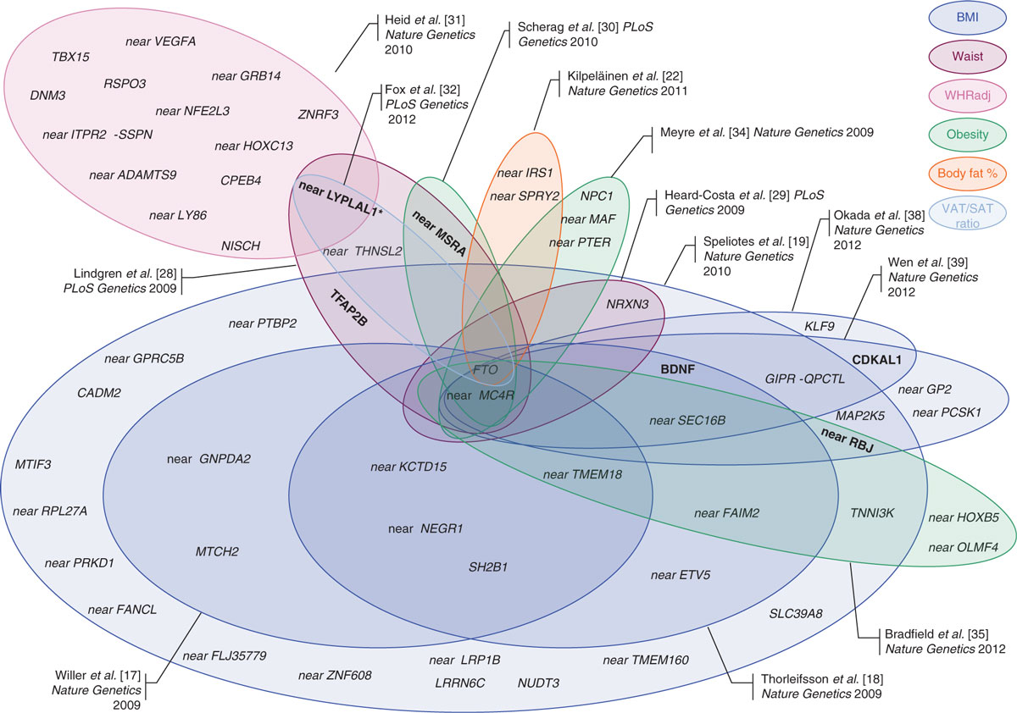
(Lu and Loos Genome Medicine 2013; Locke et al, Nature 2015)
Genome-Wide Association Studies (GWAS) have identified 97 genetic loci associated with BMI and over 500 associated with obesity-susceptibility

Slide 8
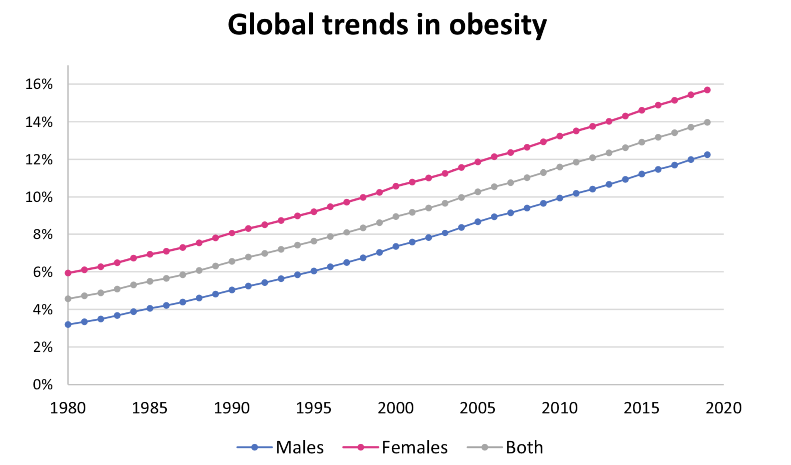
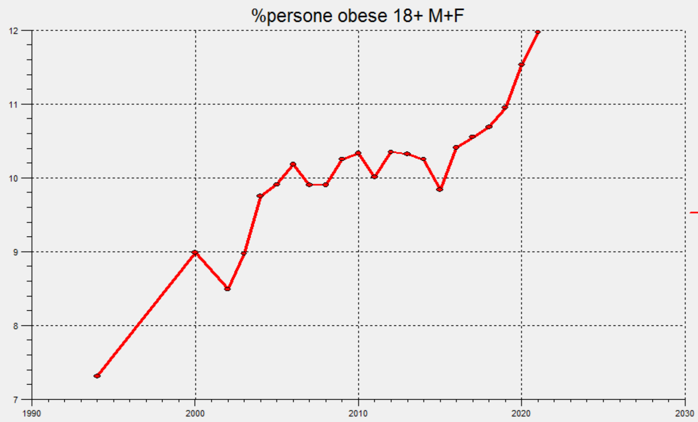

Obesità in Italia
Data from the Global Burden of Disease Study
Boutari et al, Metabolism 133 (2022) 155217
+61% in 27 anni

Slide 9
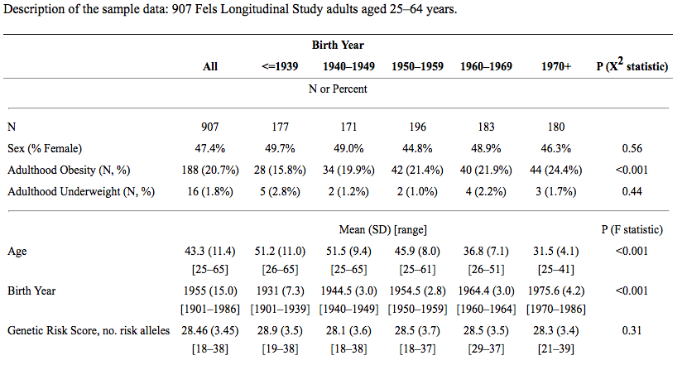
Fels Longitudinal Study (USA)
The obesity rate increased according to birth year
The genetic risk score remained stable
(Demerath et al, Hum Ered 2013)

Slide 10
“Genes may co-determine who becomes obese, but our environment determines how many become obese.”
(J Lennert Veerman, PLoS Med 2011)

Slide 11
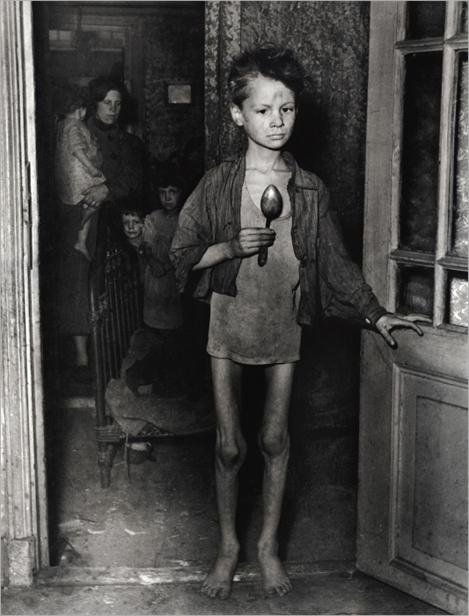
Carestia olandese (Dutch famine) durante l'occupazione tedesca nel 1944
Occasione nutrizionale/scientifica unica
Iniziò e terminò improvvisamente
Durò solo 5 mesi
Fu preceduta e seguita da periodi di normale nutrizione
Ha contribuito a svelare il ruolo fondamentale dell'epigenetica

Slide 12
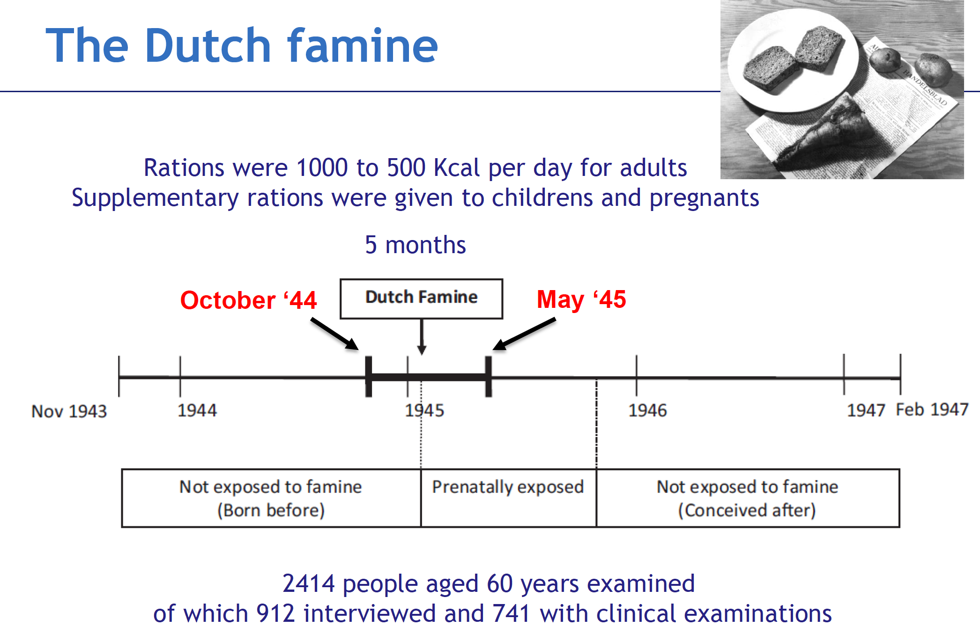

Slide 13
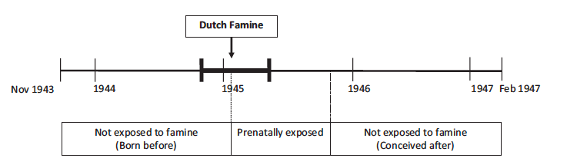



Results from the Dutch famine studies
F1 men, 19yrs (Ravelli et al, 1976)
Men who were conceived during the Dutch famine had higher rates of obesity than those conceived before or after it

Slide 14

Results from the Dutch famine studies
F1 men, 19yrs (Ravelli et al, 1976)
F1 women, later life (Ravelli et al, 1999)
Maternal malnutrition in early gestation was also associated with higher BMI and waist circumference in 50-y-old women

Slide 15
Results from the Dutch famine studies
F1 men, 19yrs (Ravelli et al, 1976)
F1 women, later life (Ravelli et al, 1999)
Grandchildren had increased BMI in adult age
Higher BMI in F2 offsprings (Veenendaal et al, 2012)

Slide 16
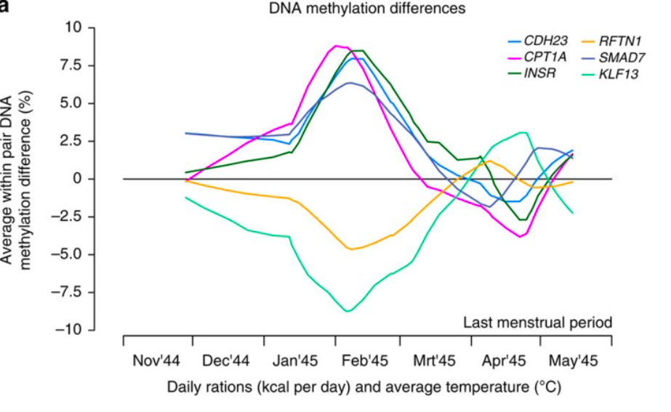
Results from the Dutch famine studies
Exposed subjects had different DNA methylation patterns as compared with their unexposed, same-sex siblings
(Tobi et al, Nat Commun 2014)

Slide 17
- decreased expression of genes involved in oxidative phosphorylation; carbohydrate, amino acid, and lipid metabolism;
- increased expression of genes involved in inflammation and glycan degradation
In monozygotic twin pairs, candidate genes for obesity and T2D can be differentially expressed in discordant twins
(Nilsson et al. Diabetes 2014;63:2962-2976)

Slide 18
A continuous stream of information interacting with our cells
Environment and lifestyle
Epigenetic alterations may functionally link an altered environment with gene expression
Epigenome
(histone modifications, DNA methylation, miRNA mediated gene silencing)
Inherited genome, gene polymorphism
Disease onset / progression

Slide 19
Diet, lifestyle and epigenome
High-fat/high calorie diets
Excessive fructose consumption
Dietary fatty acids
Fiber consumption
Associated with epigenetic variations (mainly DNA methylation)
Low physical activity
Smoking
Excessive alcohol intake
Chronic stress
Personal choices as dietary habits and lifestyle can affect the epigenome, and epigenetic changes are emerging as early markers of metabolic dysfunction

Slide 20

L'epidemiologia colpevolizzante
La responsabilità della crescita epidemica delle malattie cardio-metaboliche e del cancro non può essere interamente attribuita agli individui e alle cosiddette “abitudini voluttuarie”
Numerosissime evidenze attribuiscono un ruolo critico e crescente ad esposizioni involontarie a inquinanti atmosferici e ad interferenti endocrini ampiamente diffusi nell’ambiente di vita

Slide 21

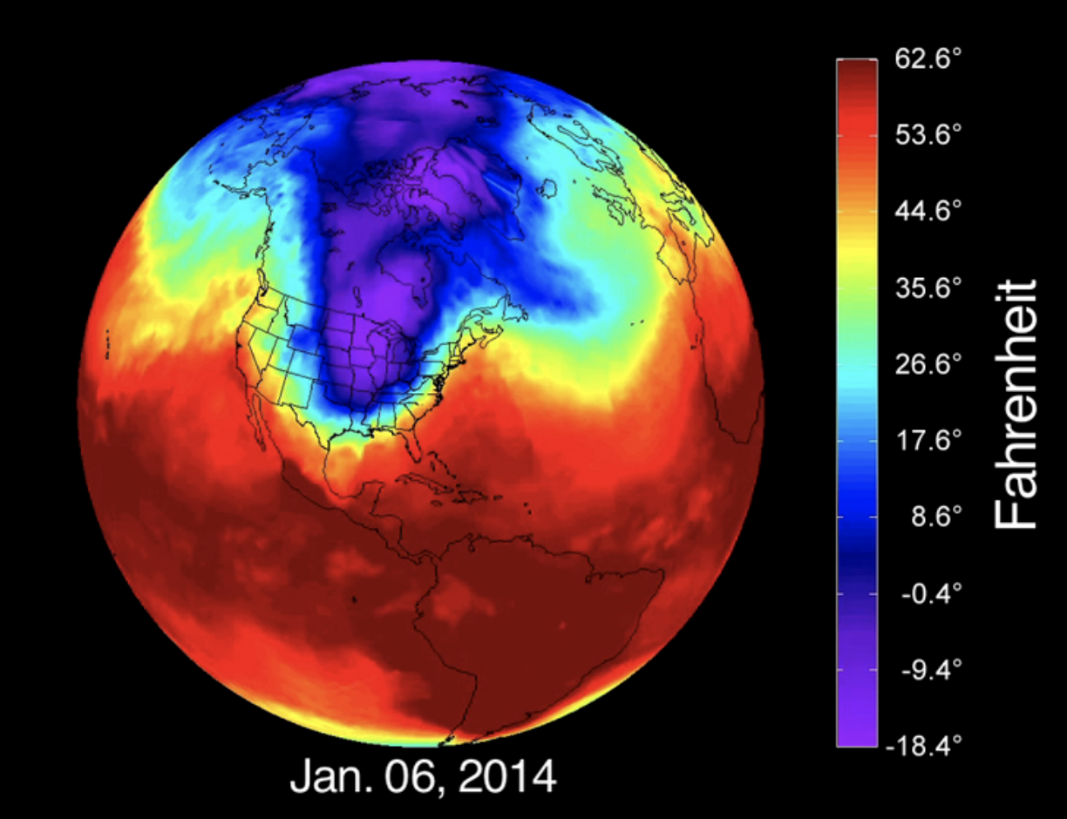
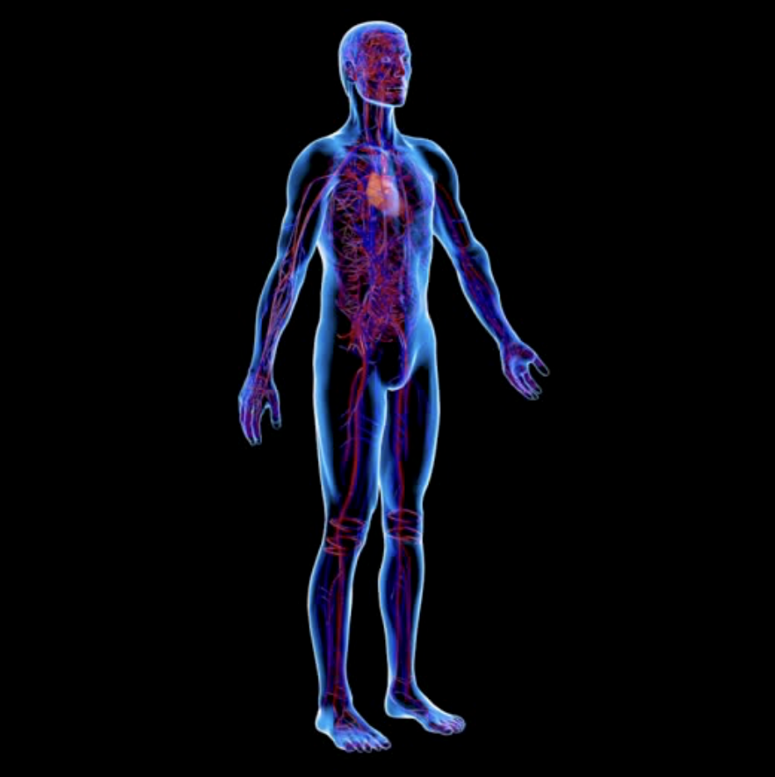
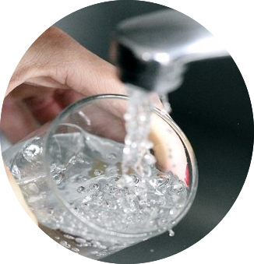



energia
materia
L’essere umano è un laboratorio di biochimica che, per funzionare, ha bisogno di risorse esterne
L’ambiente è un determinante fondamentale della salute umana

Slide 22



Slide 23
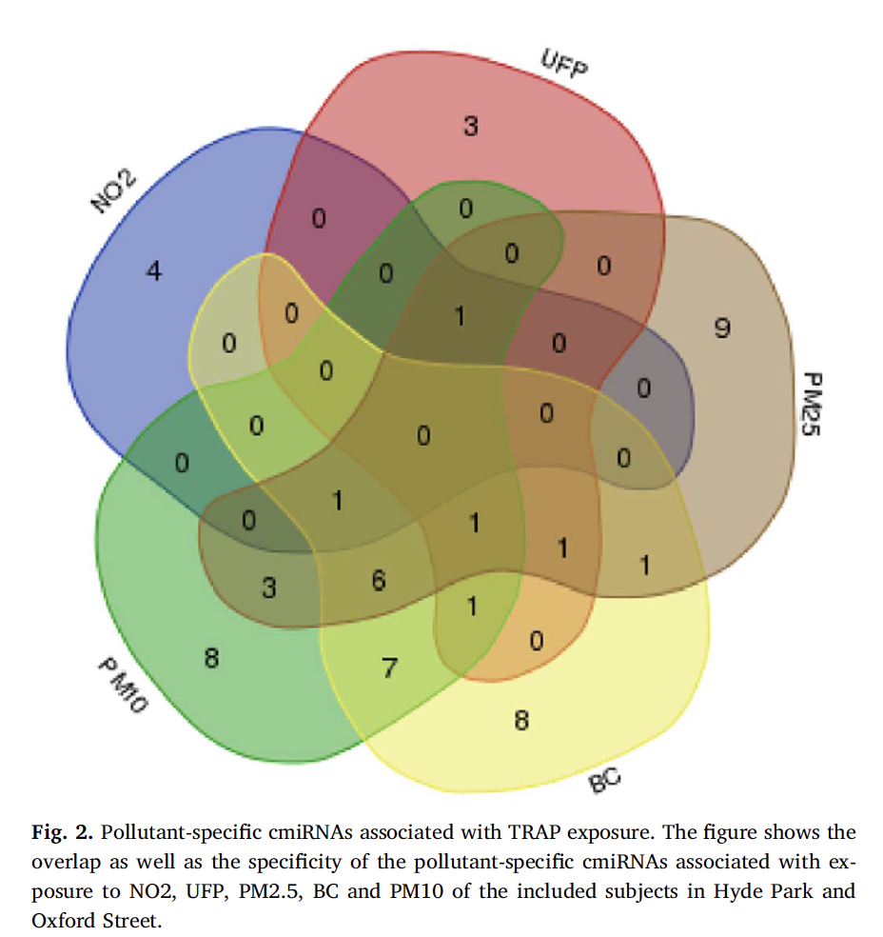
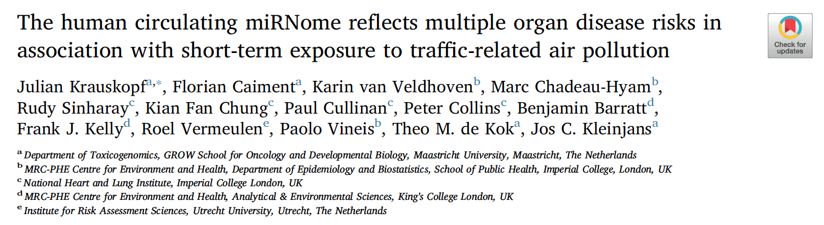
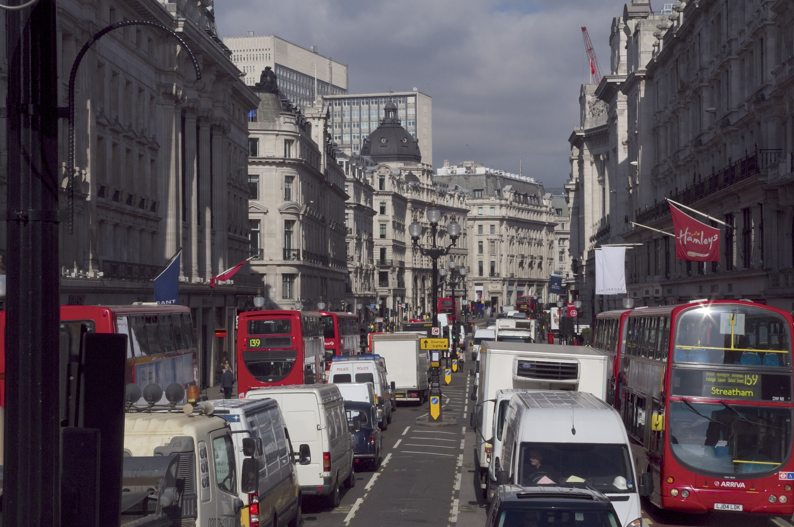

Oxford street
Hyde Park
2hr exposure to air pollutants (NO2, UFP, PM2.5, BC and PM10) associated to 54 miRNAs highly expressed in the breast, in the heart, in the kidney, in the liver, in the pancreas, in the spleen and in the brain
Previous link with breast cancer, inflammation, cardiovascular, kidney, neurodegenerative and respiratory diseases
Krauskopf et al, Environment International 2018

Slide 24
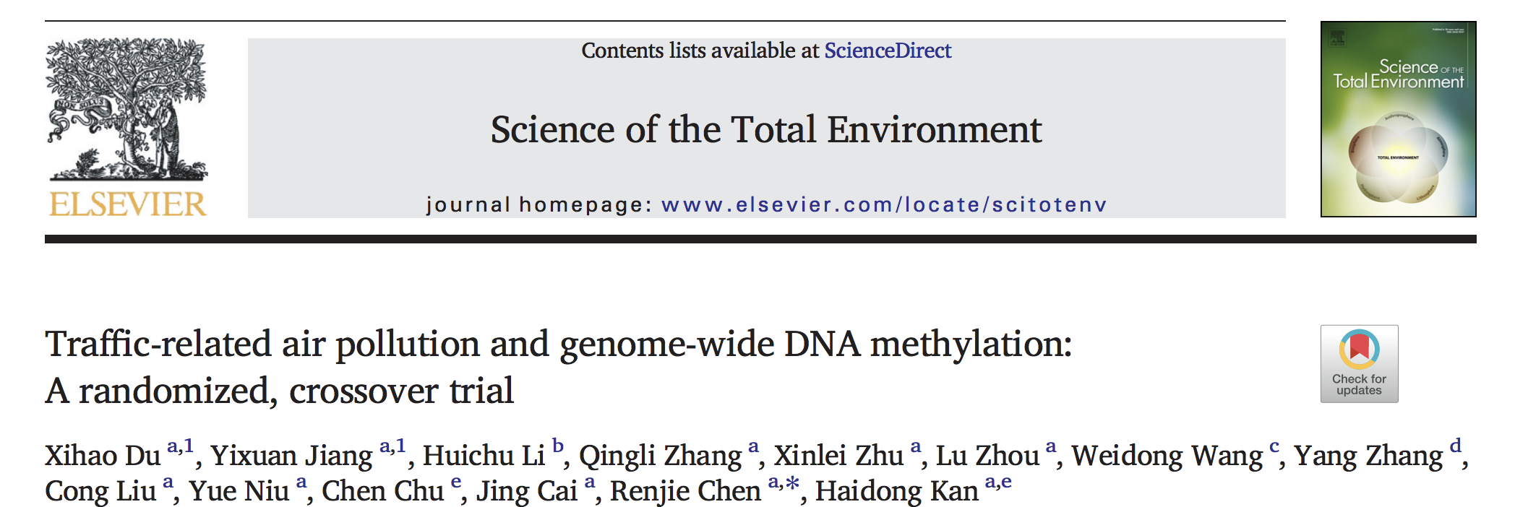
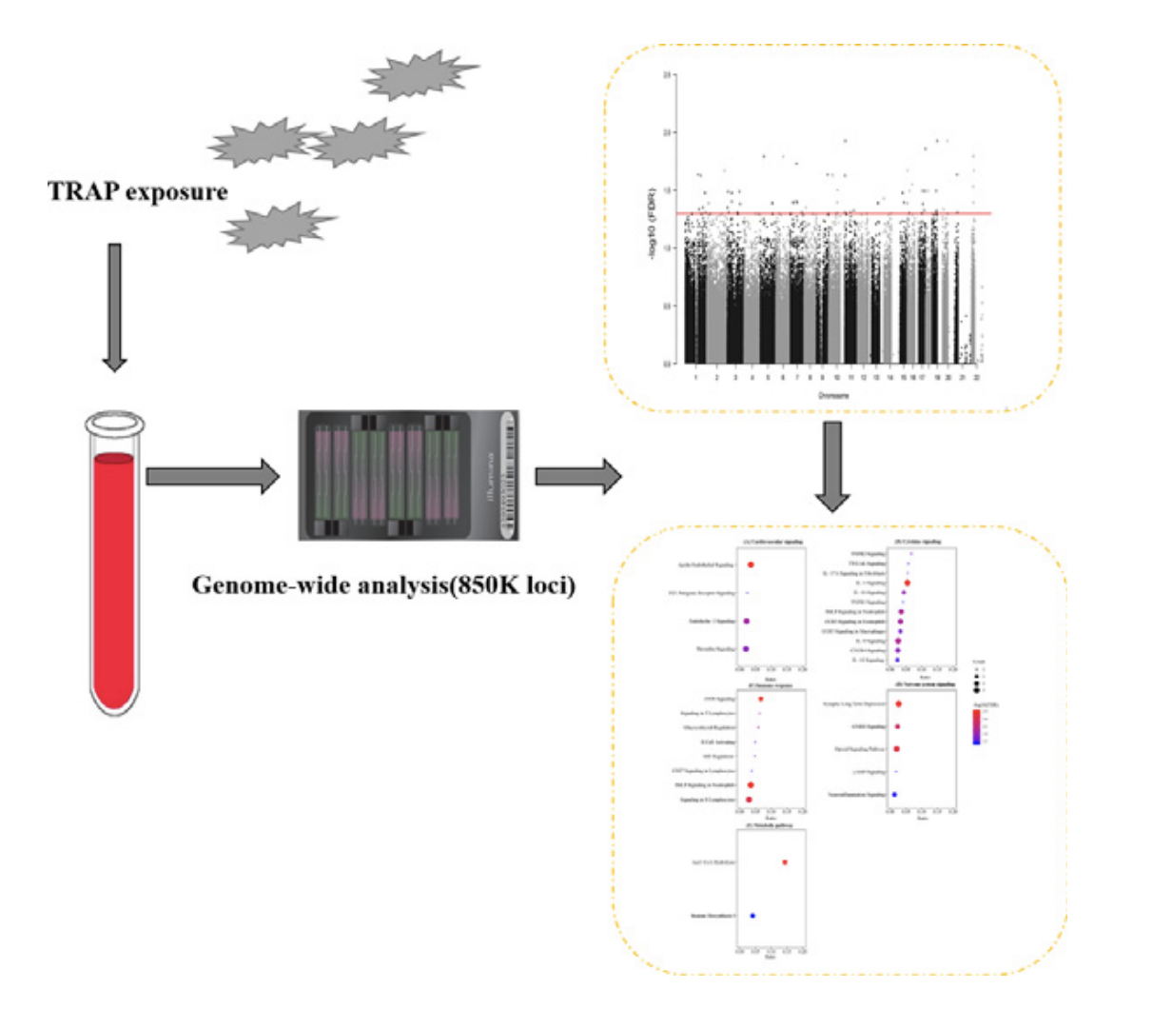
35 healthy Chinese adults randomly allocated to a traffic-free park or a main road for consecutive 4 h
Methylation levels of 68 CpG loci were significantly changed following TRAP exposure
The annotated genes based on the differential CpGs loci were related to pathways in cardiovascular signaling, cytokine signaling, immune response, nervous system signaling, and metabolism
"Traffic related air pollution (TRAP) exposure was associated with DNA methylation in dozens of genes concerning cardiometabolic health"
Sci Total Environ. 2022 Dec 1;850:157968

Slide 25
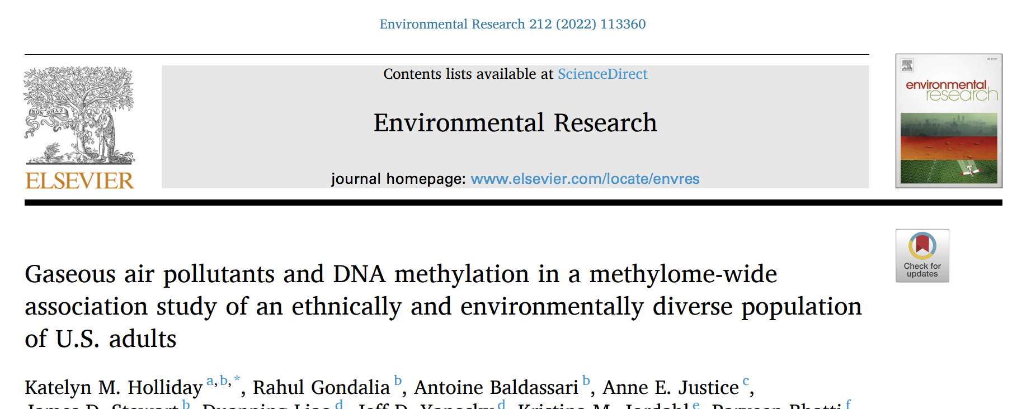
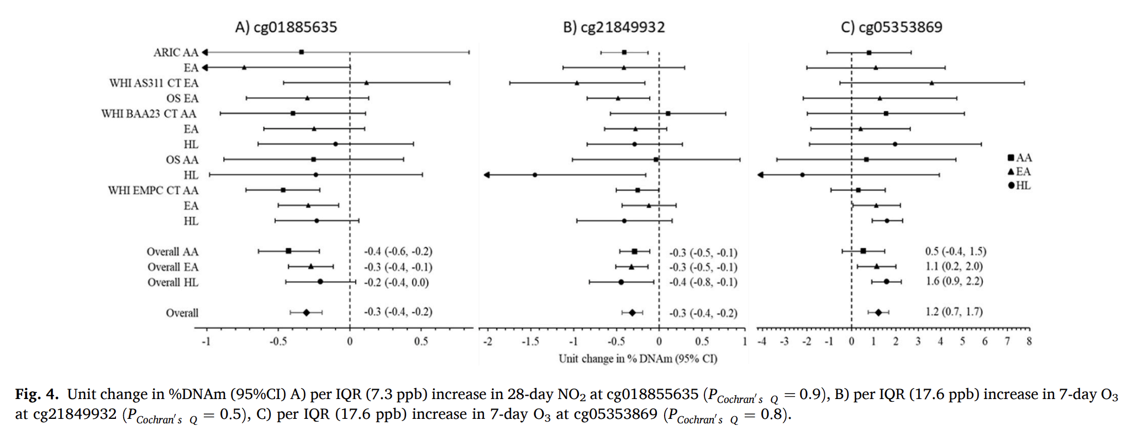
Women's Health Initiative (WHI) and Atherosclerosis Risk in Communities (ARIC) cohorts (n = 8397; mean age 61.3 years)
NO2, O3
We identified three CpG sites potentially susceptible to gaseous air pollution-induced DNAm changes near genes relevant for cardiovascular and lung disease.

Slide 26
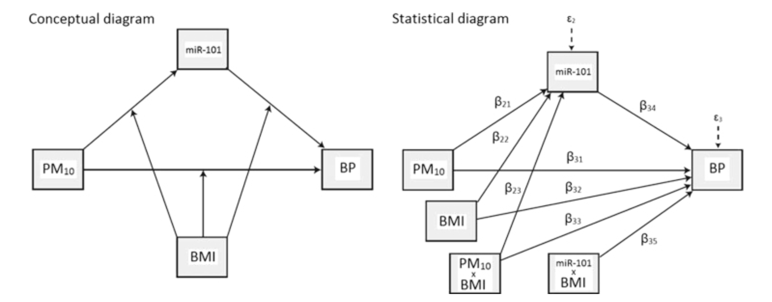
The role of epigenome in CV diseases
In 90 obese subjects, PM10 exposure 24 and 48 h before the recruitment day was associated with increased systolic/diastolic BP, and increased levels of 9 miRNA
Diastolic BP was predicted by miR-101xBMI statistical interaction
Motta V et al, Environ Res 2016

Slide 27
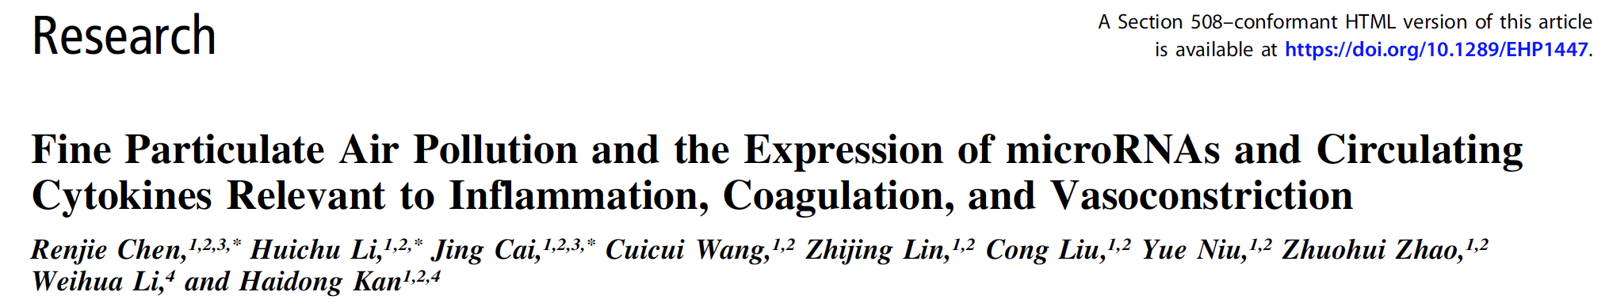
The role of epigenome in CV diseases
Serum concentrations of pro-inflammatory cytokines may contribute to systemic inflammation, platelet activation, and endothelial dysfunction
In healthy students PM2.5 exposure was positively associated with the expression of cytokines (IL1, IL6, TNF, TLR2, F3, endothelin 1) and negatively linked with 5 miRNAs involved in cytokine expression
Chen R et al, EHP 2018

Slide 28





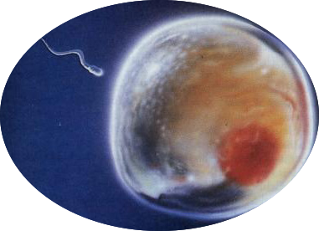
Quando agiscono i meccanismi epigenetici?
Periodo a maggior rischio

Slide 29
Quanto durano gli effetti delle modifiche epigenetiche?
Possono essere stabili nel tempo
Possono persistere anche in assenza di ciò che le ha generate (memoria biologica)
Possono essere ereditabili (trasmissione transgenerazionale)

Slide 30

Prof. Lorenzo Tomatis
“Le future generazioni non ci perdoneranno il male che stiamo facendo loro…”

Slide 31
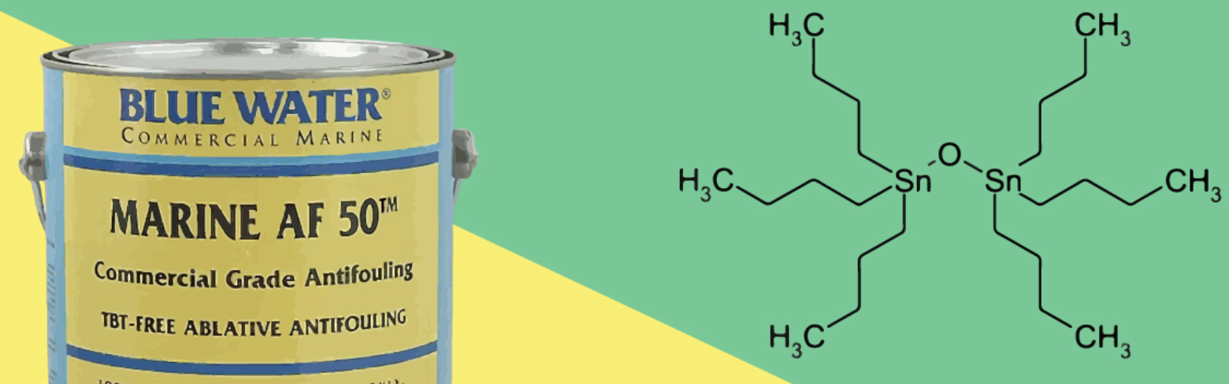
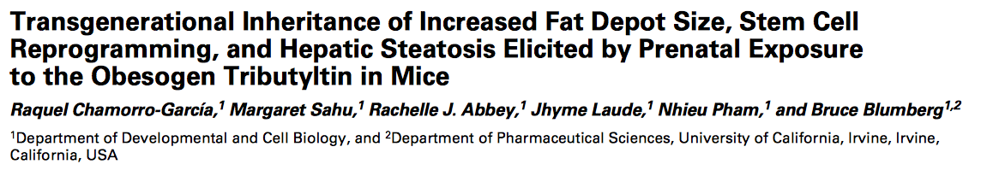
Tributilstagno
Usato per oltre 40 anni:
Vernici antivegetative per natanti
Stabilizzanti nelle plastiche
Disinfettanti contro i funghi nel legno, nei tessili, nel cuoio, nella carta, nei refrigeranti industriali e nelle sementi
Acque di scarico industriali
Prenatal tributyltin (TBT)
Induced hepatic lipid accumulation
up-regulated hepatic expression of genes involved in lipid storage/transport, lipogenesis, and lipolysis
Vietato dal 2008 nell'unione Europea
In three subsequent generations

Slide 32
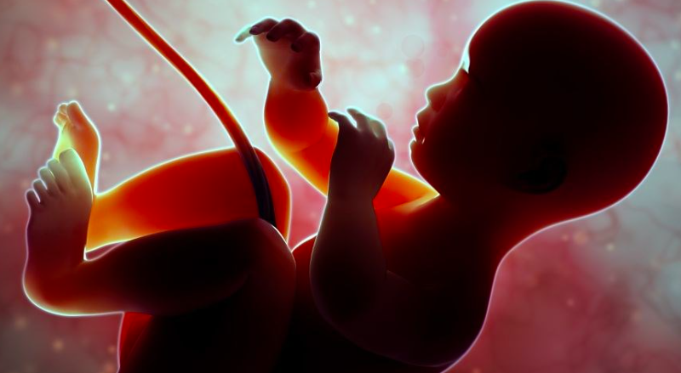
Fetal programming
Nutritional status
Stress
Pollutants
Disease onset and progression
Maternal exposure to environmental factors during pregnancy can influence the metabolic phenotype of the offspring through a fetal programming of later diseases by epigenetic mechanisms affecting gene expression, without modifications of the DNA sequence

Slide 33
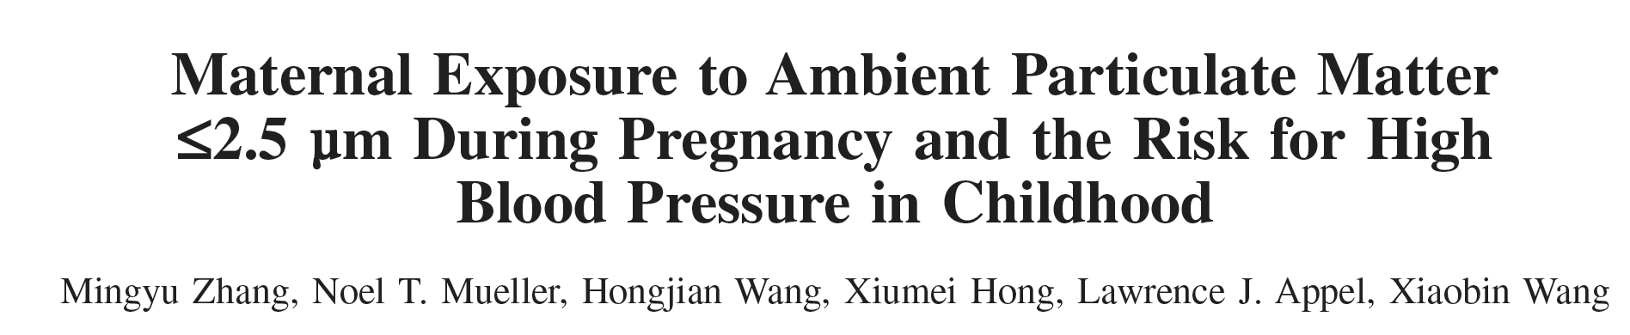

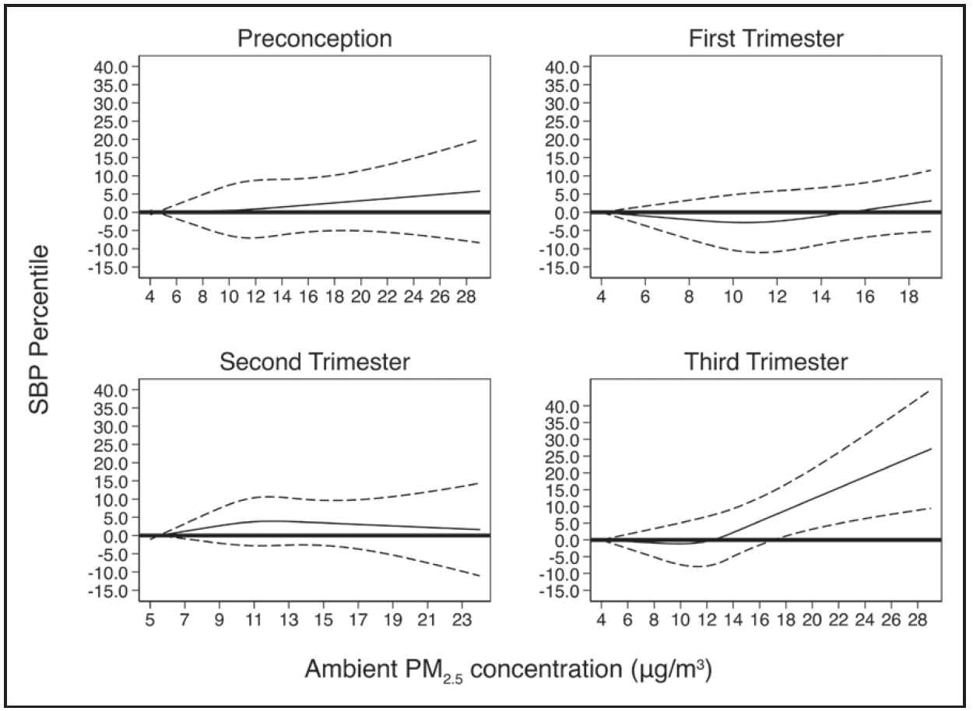
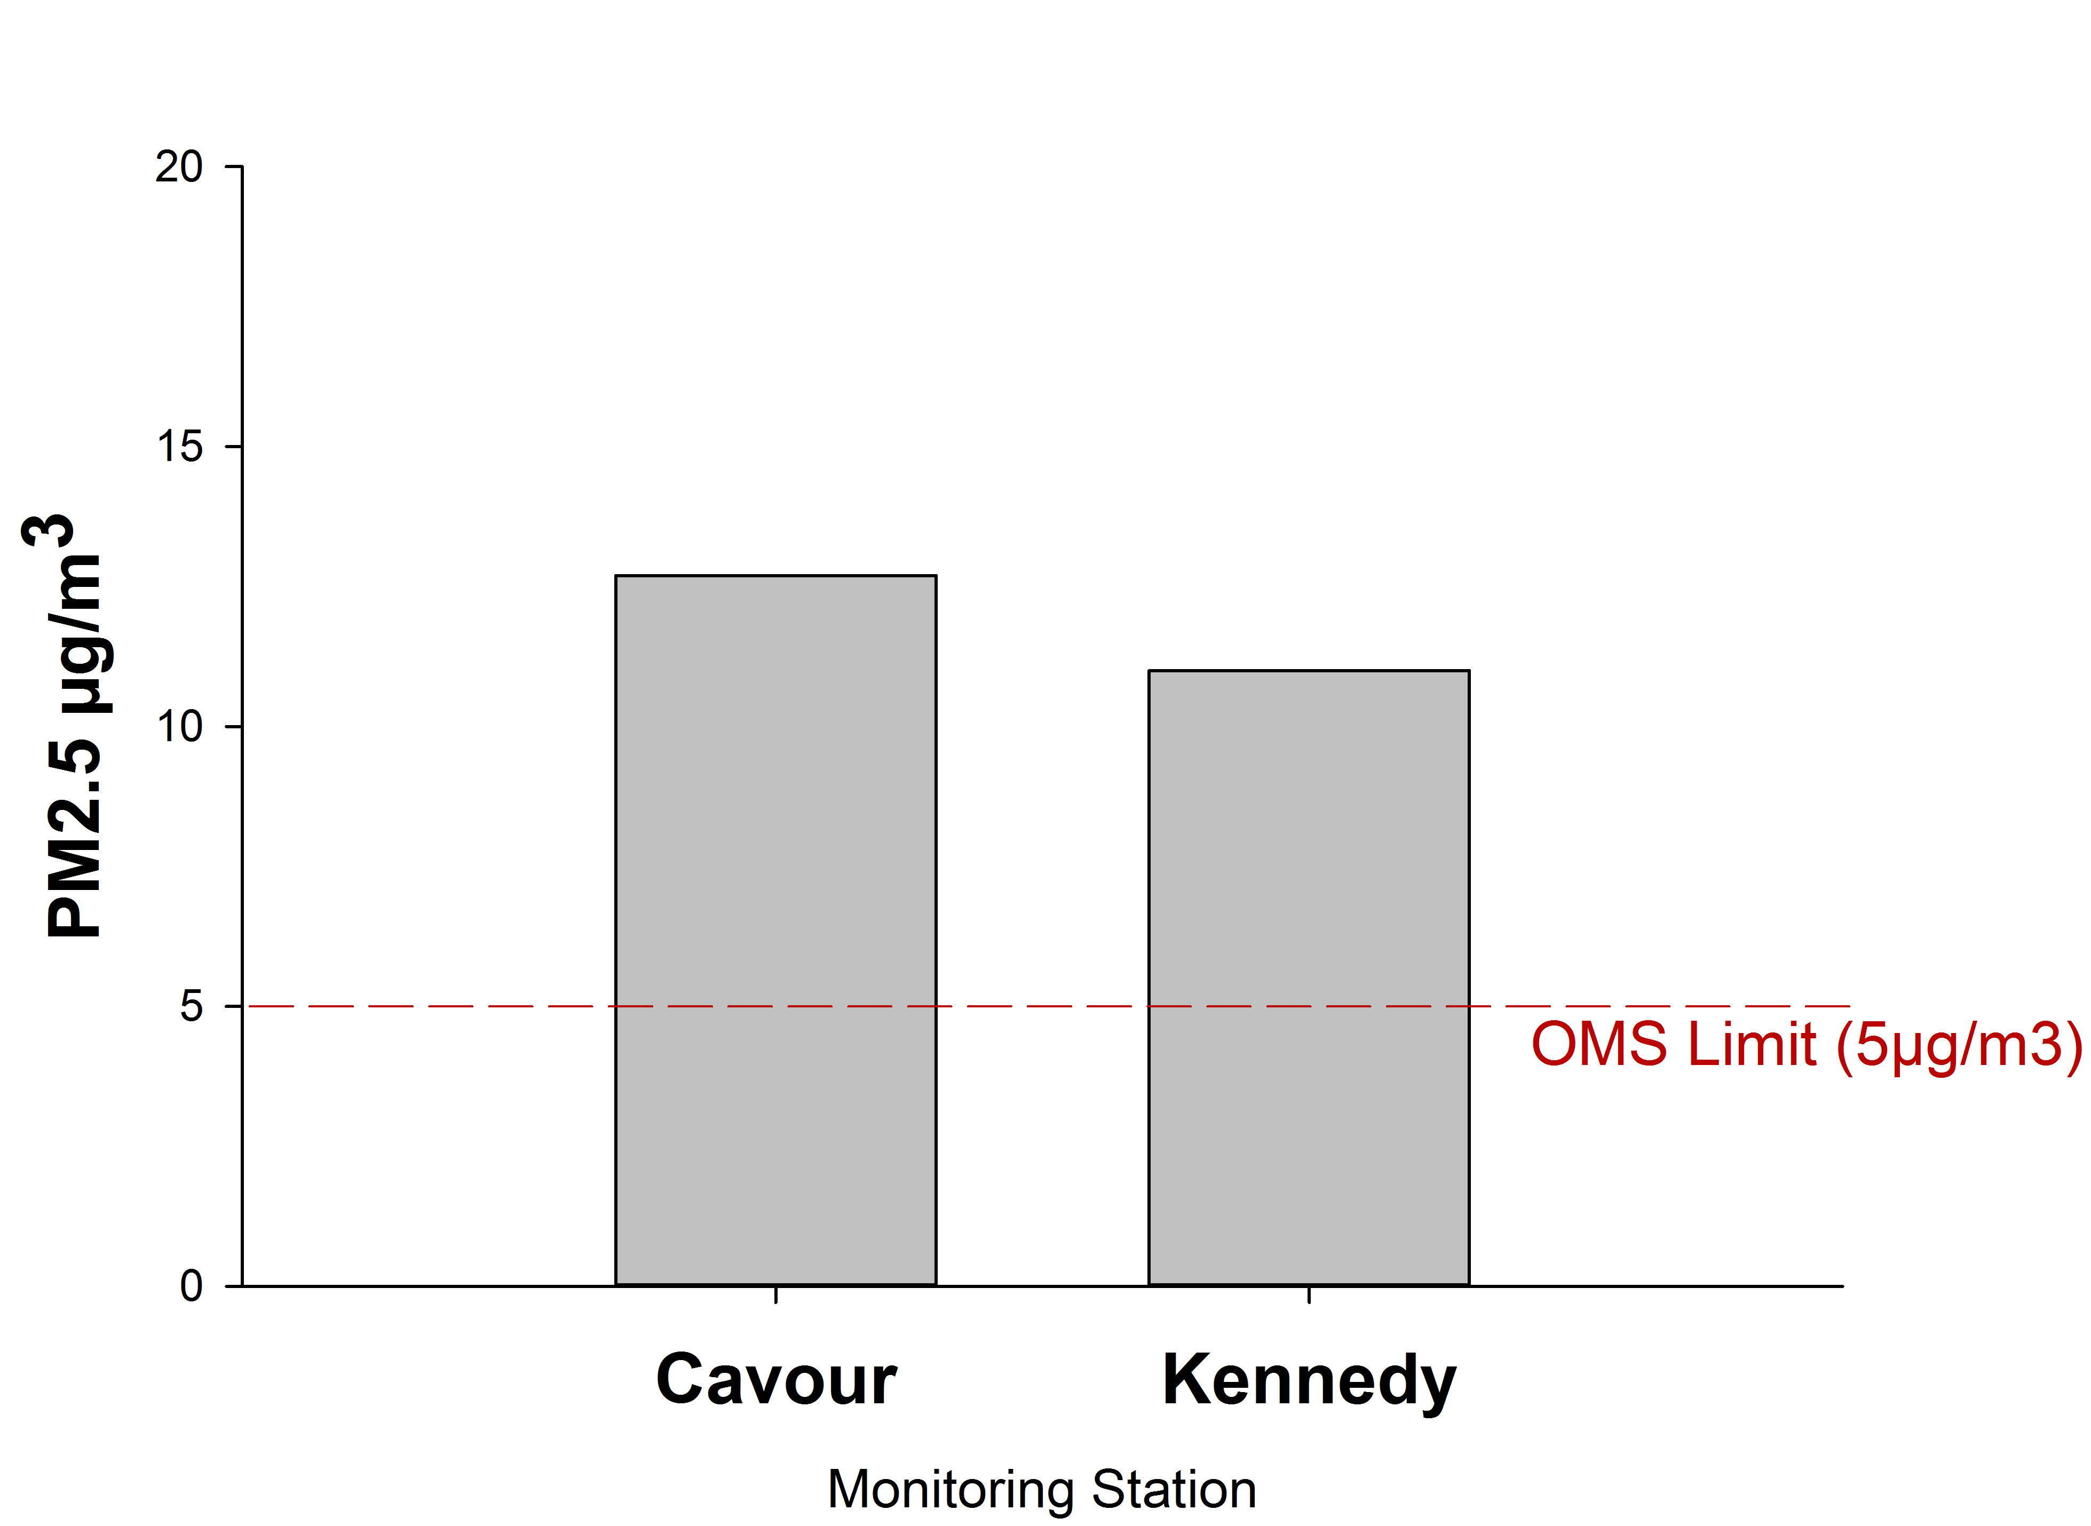
The role of epigenome in CV diseases
Studio prospettico - 1293 madri (Boston Birth Cohort) e rispettivi figli;
follow-up tra 3 e 9 anni di età
Aumentato rischio di ipertensione se esposti in utero durante il terzo trimestre di gravidanza a concentrazioni di PM2.5 >13 μg/m3
Rischio aumentato di 1.47 volte ogni incremento di PM2.5 di 5 μg/m3
Zhang M et al, Hypertension 2018

Slide 34
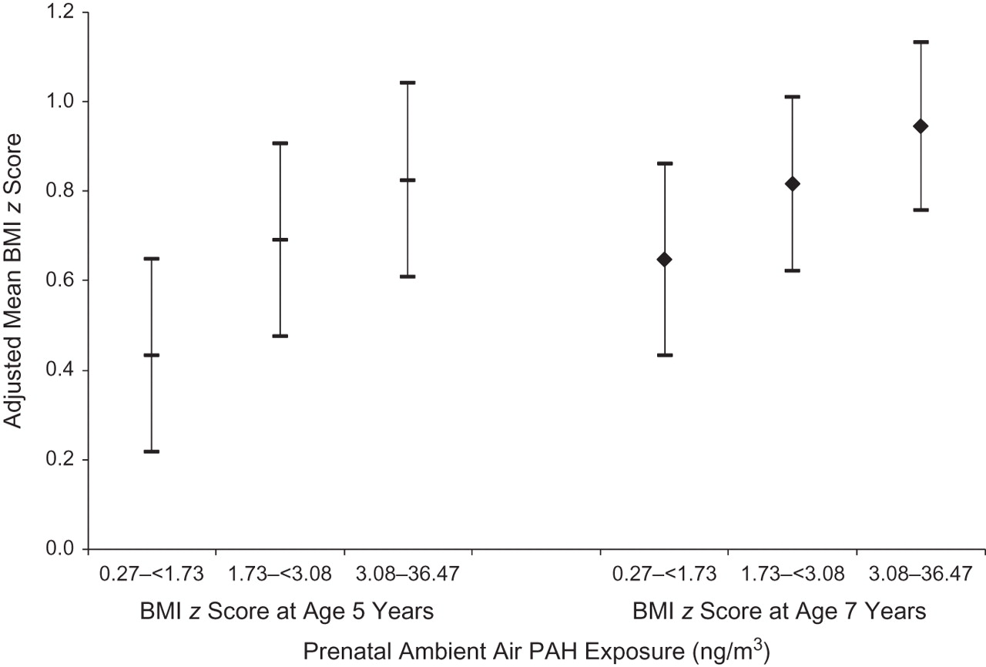
Late effects following prenatal exposure
PAH exposure and obesity
Covariate-adjusted mean body mass index (BMI) z scores according to tertile of PRENATAL ambient air polycyclic aromatic hydrocarbon (PAH) exposure for children at ages 5 and 7 years
[Mothers and Children Study in Northern Manhattan and the South Bronx, 1998–2011]
Andrew Rundle et al. Am. J. Epid. 2012;175:1163

Slide 35
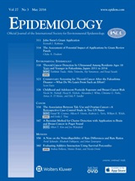


“A 10 μg/m3 higher NO2 exposure during pregnancy was associated with 1.4 fewer points (95%CI:-2.6 to -0.20) of Verbal IQ, and 1.4 fewer points (95%CI:-2.7 to -0.20) of Verbal Comprehension IQ“

Slide 36
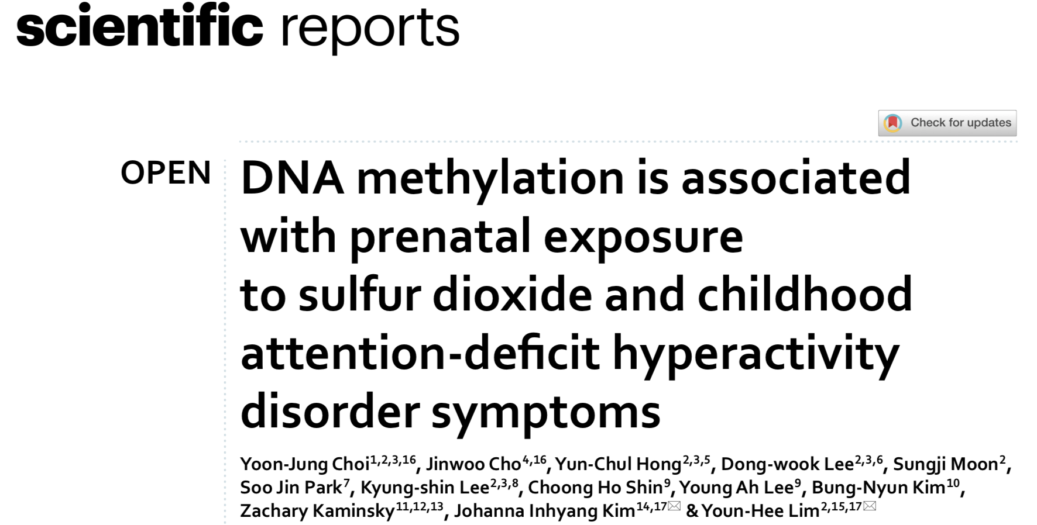
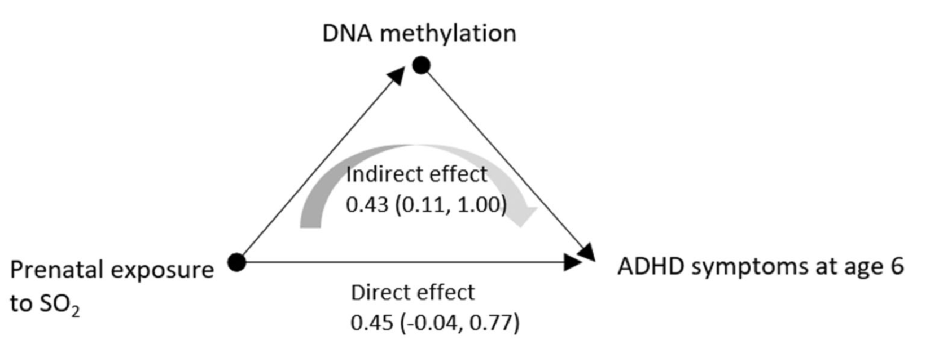
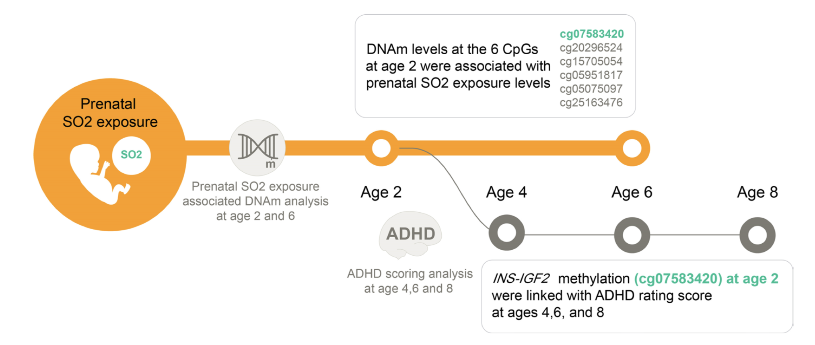
mother-child cohort (n = 329)
Sci Rep. 2023 Mar 1;13(1):3501

Slide 37
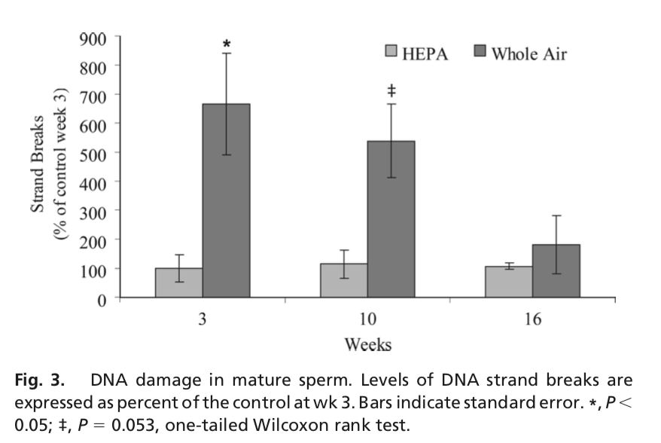
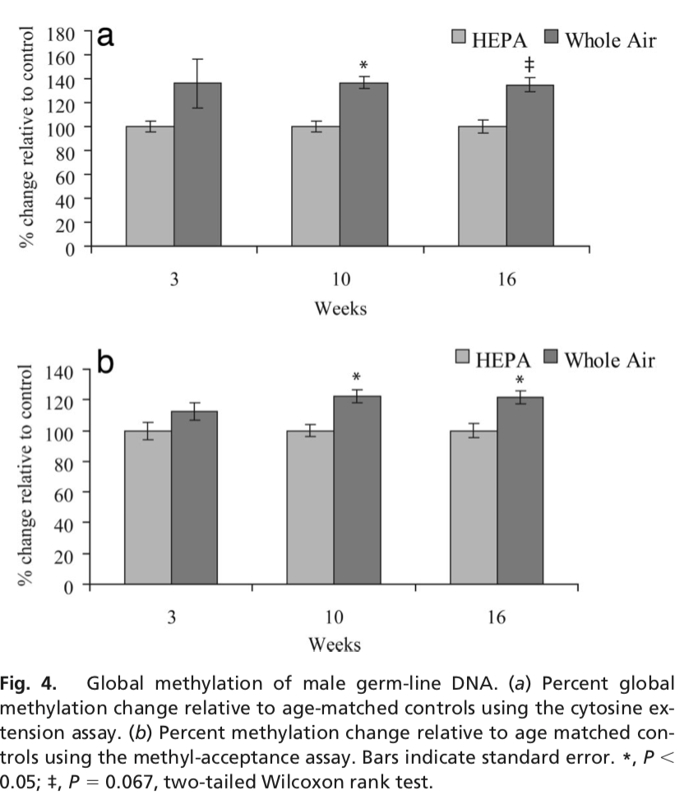
Danno genetico e modificazioni epigenetiche (metilazione) in cellule germinali esposte a particolato atmosferico
Yauk C et al, Proc Natl Acad Sci U S A. 2008 Jan 15;105(2):605-10

Slide 38
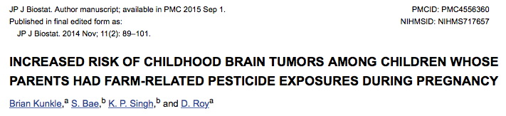
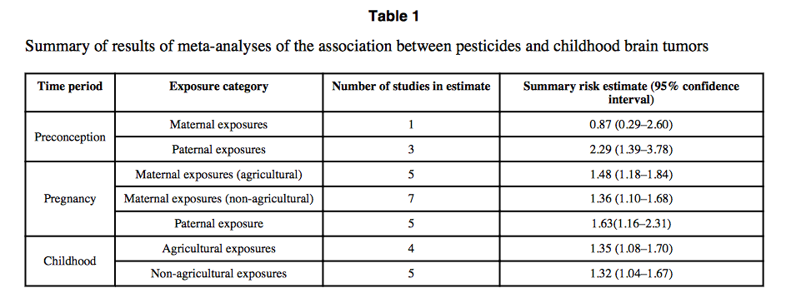
Per esposizione pre-concezionale del PADRE
Per esposizione in gravidanza della MADRE (residenza in campi agricoli)
Per esposizione in gravidanza della MADRE (ingestione)
Per esposizione diretta del BAMBINO (residenza/ingestione)
A. Di Ciaula - ISDE

Slide 39
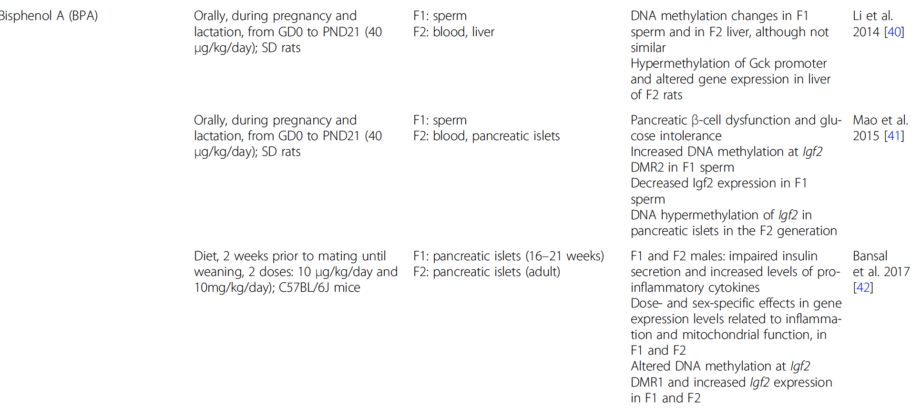
Methylation aberrancies in sperm in F1 generation
Maternal BPA exposure during gestation and/or lactation:
Disrupts glucose homeostasis in F2 offspring rats (DNA hypermethylation of Glucokinase promoter)
Induces beta-cell dysfunction and glucose intolerance in F2 offspring rats (DNA hypermethylation of Igf2 in pancreatic islets)
Impairs insulin secretion, increases levels of proinflammatory cytokines in F1 and F2 offspring rats (DNA hypermethylation of Igf2 expression)
(Van Cauwenbergh et al. Clinical Epigenetics 2020)

Slide 40
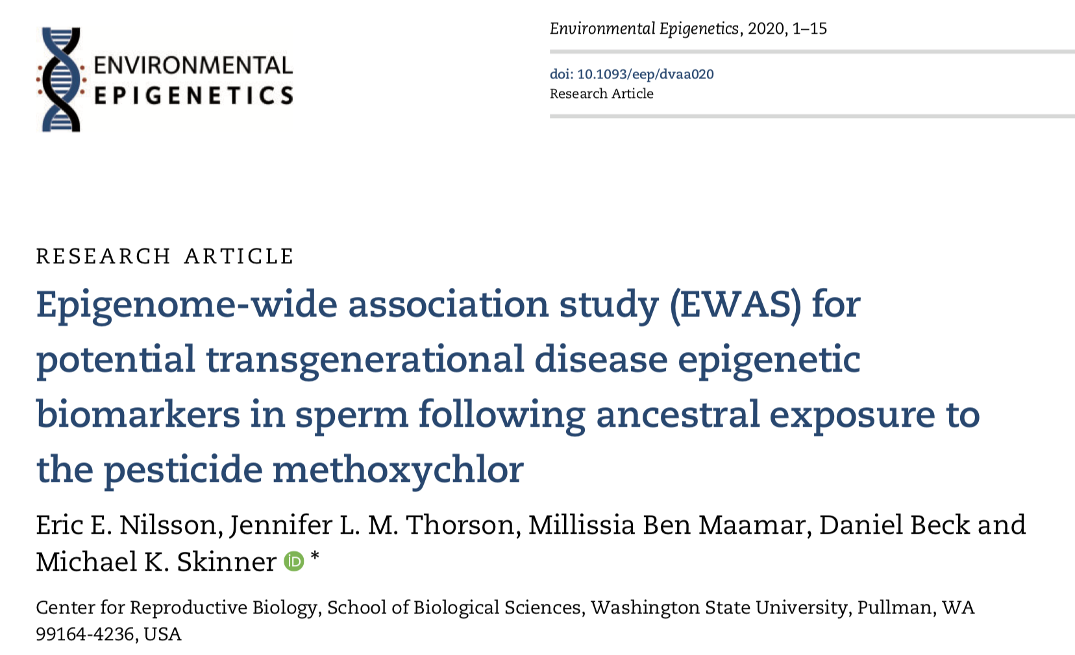
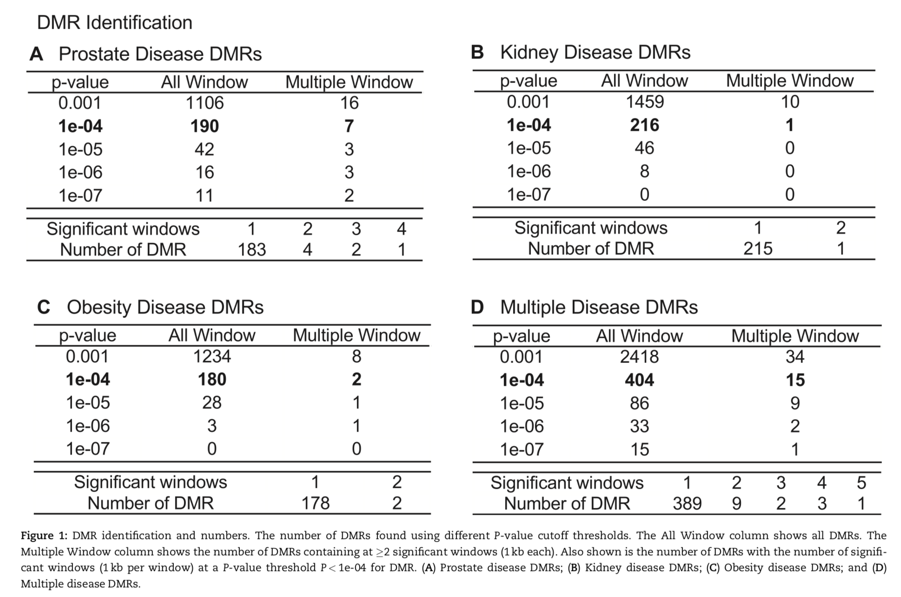
differential DNA methylation regions are associated with particular disease states in the F3 generation great-grand offspring of F0 generation rats exposed during gestation to the agricultural pesticide methoxychlor
specific patterns of DMRs for these transgenerational rats that can potentially serve as epigenetic biomarkers for prostate disease, kidney disease, obesity, and the presence of multiple diseases

Slide 41
Le modificazioni epigenetiche possono essere reversibili !
Fondamentale importanza per misure di prevenzione primaria e secondaria

Slide 42
Conclusioni
Le modificazioni epigenetiche possono essere modulate da alimentazione e stili di vita ma anche da esposizioni involontarie. Viviamo in continuo equilibrio dinamico in grado di causare danni (o di prevenirli) dall’epoca prenatale all’età geriatrica
L’epigenetica è la principale interfaccia tra i determinanti ambientali di salute e le modalità di espressione del nostro patrimonio genetico. Vivere in un ambiente salubre o insalubre influenza pesantemente il rischio sanitario di individui e comunità
Le evidenze scientifiche disponibili sono tali da imporre efficaci e urgenti politiche di prevenzione primaria, finalizzate a ridurre il rischio sanitario in qualunque fascia di età
I meccanismi epigenetici possono avere conseguenze transgenerazionali. L’inquinamento che viviamo qui e ora potrà avere conseguenze almeno su tre generazioni successive.

Slide 43

Grazie per l'attenzione

